Slide 1
Darknets: Fun and games with anonymizing private networks
Adrian Crenshaw

Slide 2
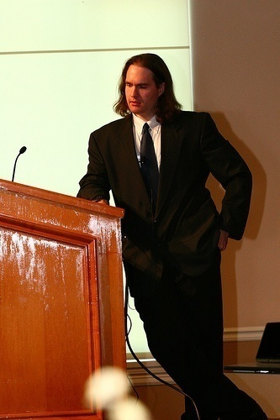
About Adrian
I run Irongeek.com
I have an interest in InfoSec education
I don’t know everything - I’m just a geek with time on my hands
Notes:
Take a note from Johnny Long’s book, and Bruce Potter’s book.

Slide 3
What is this talk about
Darknets
There are many definitions, but mine is “anonymizing private networks ”
Use of encryption and proxies (some times other peers) to obfuscate who is communicating to whom

Slide 4
Isn’t the Internet anonymous enough?
Not really
IPs can be associated with ISPs
Bills have to be paid
Websites log IPs as a matter of course
ISPs can look at their logs for who was leased an IP
Lots of plain text protocols allow for easy sniffing
http://www.irongeek.com/i.php?page=security/ipinfo
http://www.irongeek.com/i.php?page=security/AQuickIntrotoSniffers
http://www.irongeek.com/i.php?page=videos/footprinting-scoping-and-recon-with-dns-google-hacking-and-metadata

Slide 5
Who cares?
Privacy enthusiasts and those worried about censorship
Firms worried about policy compliance and leaked data
Law enforcement

Slide 6


Average Citizen
Why do you care?
Do you want to stay anonymous?
P2P
Censorship
Privacy

Slide 7
Corporations
Why do you care?
Is someone sneaking out private data?
Trade secrets
Personally identifiable information

Slide 8

Law Enforcement
Why do you care?
Contraband and bad people everywhere
Criminals
Terrorists
Pedos

Slide 9
Some key terms
Proxy
Something that does something for something else
Encryption
Obfuscating a message with an algorithm and one or more keys
Signing
Using public key cryptography, a message can be verified based on a signature that in all likelihood had to be made by a signer that had the secret key
Small world model
Ever heard of six degrees of Kevin Bacon?

Slide 10

Tor
The Onion Router

Slide 11
Overview
Who?
First the US Naval Research Laboratory, then the EFF and now the Tor Project (501c3 non-profit).
http://www.torproject.org/
Why?
“Tor is free software and an open network that helps you defend against a form of network surveillance that threatens personal freedom and privacy, confidential business activities and relationships, and state security known as traffic analysis.” ~ As defined by their site
What?
Access normal Internet sites anonymously, and Tor hidden services.
How?
Locally run SOCKS proxy that connects to the Tor network.

Slide 12
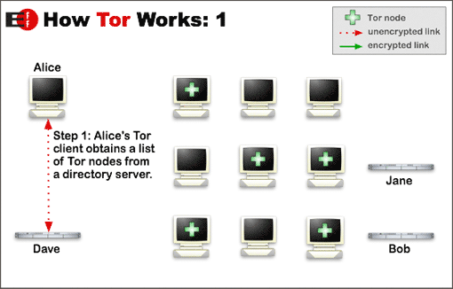
Layout
Image from http://www.torproject.org/overview.html.en

Slide 13
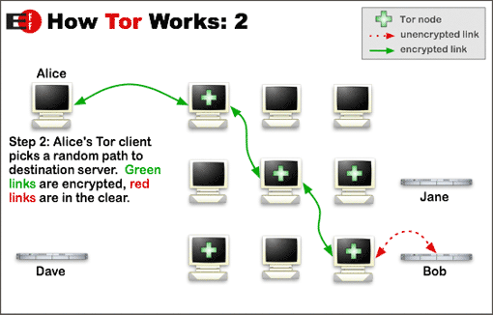
Layout
Image from http://www.torproject.org/overview.html.en

Slide 14
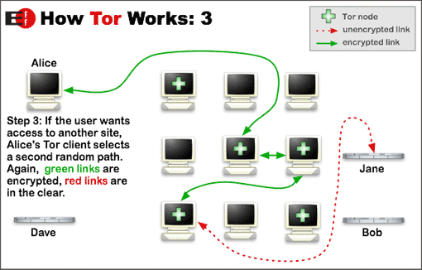
Layout
Image from http://www.torproject.org/overview.html.en

Slide 15
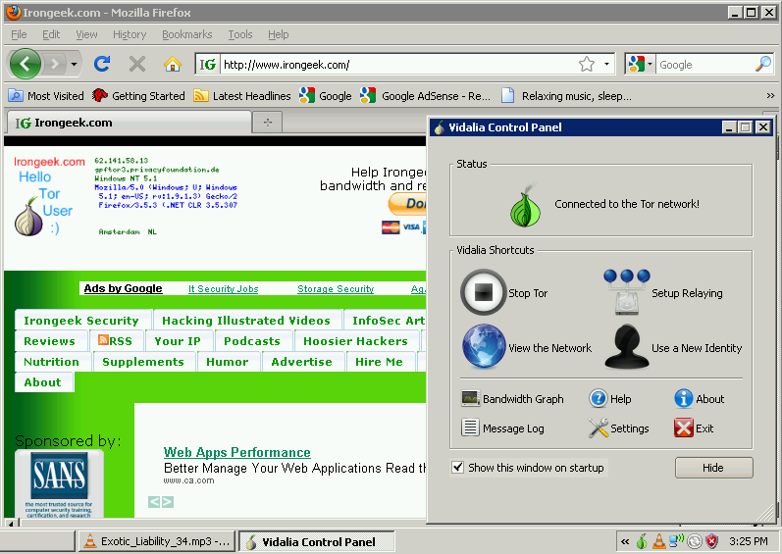
What does it look like to the user?

Slide 16
Applications/Sites
Anonymous proxy to the normal web
http://www.irongeek.com/i.php?page=videos/tor-1
Hidden services
Normally websites, but can be just about any TCP connection
http://www.irongeek.com/i.php?page=videos/tor-hidden-services
Tor2Web Proxy
http://tor2web.com

Slide 17
Tor Pros and Cons
Pros
If you can tunnel it through a SOCKS proxy, you can make just about any protocol work.
Three levels of proxying, each node not knowing the one before last, makes things very anonymous.
Cons
Slow
Do you trust your exit node?
Fairly easy to tell someone is using it from the server side
http://www.irongeek.com/i.php?page=security/detect-tor-exit-node-in-php

Slide 18
What does the traffic look like?
(Keep in mind, this is just the defaults)
Local
9050/tcp Tor SOCKS proxy
9051/tcp Tor control port
8118/tcp Privoxy
Remote
443/tcp and 80/tcp mostly
Servers may also listen on port 9001/tcp, and directory information on 9030.
More details
http://www.irongeek.com/i.php?page=security/detect-tor-exit-node-in-php
http://www.room362.com/tor-the-yin-or-the-yang

Slide 19
Anonet and DarkNET Conglomeration
Roll your own, with OpenVPN and BGP routers

Slide 20
Overview
Who?
AnoNet: Good question
http://anonetnfo.brinkster.net
DarkNET Conglomeration: BadFoo.NET, ReLinked.ORG,
SmashTheStack.ORG, and SABS (perhaps a few others).
http://darknet.me
Why?
To run a separate semi-anonymous network based on normal Internet protocols.
What?
Other sites and services internal to the network, but gateways to the public Internet are possible.
How?
OpenVPN connection to the network.

Slide 21
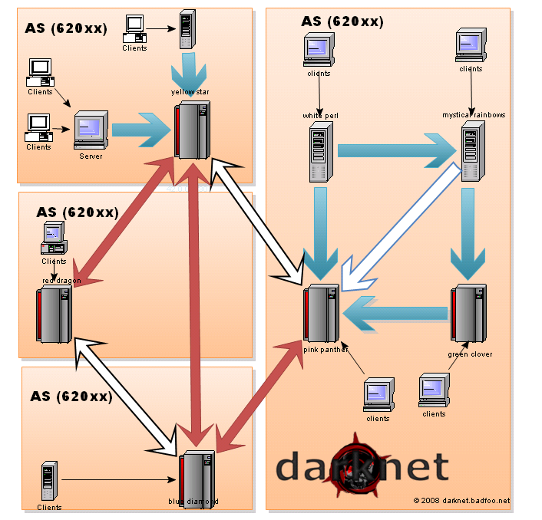
Layout
Image from http://darknet.me/whatthe.html

Slide 22
Anonet and DarkNET Conglomeration Pros and Cons
Pros
Fast
Just about any IP based protocol can be used
Cons
Not as anonymous as Tor since you can see whom you are peering with
Not a lot of services out there (DC)
Entry points seem to drop out of existence (AN)

Slide 23
What does the traffic look like?
(Keep in mind, this is just the defaults)
Whatever the OpenVPN clients and servers are configured for. I’ve seen:
AnoNet
5555/tcp
22/tcp
Darknet Conglomeration
2502/tcp

Slide 24

Freenet
All the world will be your enemy, Prince of a Thousand enemies. And when they catch you, they will kill you. But first they must catch you…
~ Watership Down

Slide 25
Overview
Who?
The Freenet Project, but started by Ian Clarke.
http://freenetproject.org/
Why?
“Freenet is free software which lets you anonymously share files, browse and publish "freesites" (web sites accessible only through Freenet) and chat on forums, without fear of censorship.”
What?
Documents and Freenet Websites for the most part, but with some extensibility.
How?
Locally run proxy of a sort that you can connect to and control via a web browser.

Slide 26
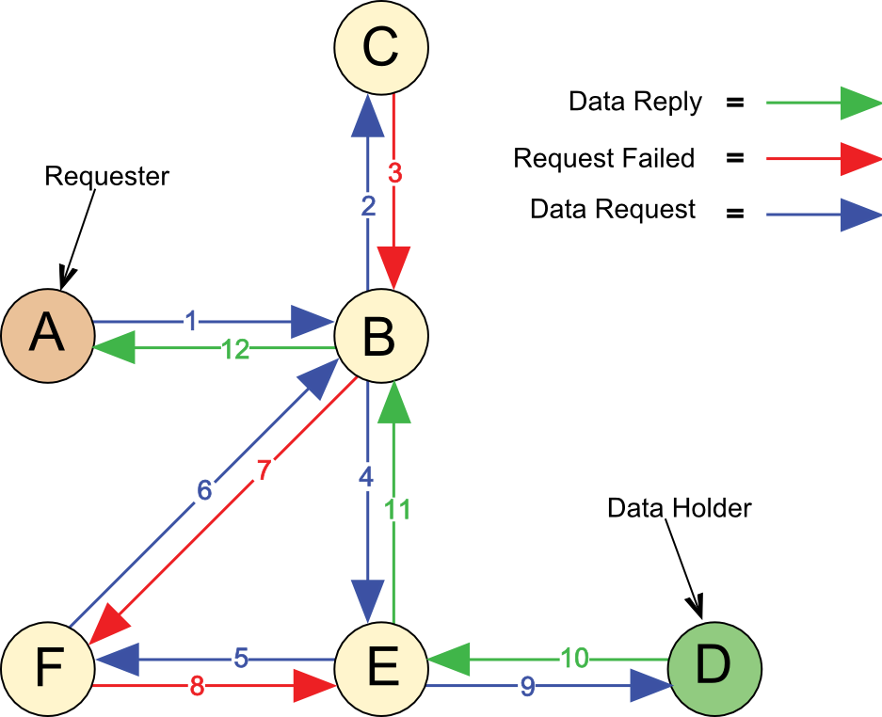
Layout
Image from http://en.wikipedia.org/wiki/File:Freenet_Request_Sequence_ZP.svg

Slide 27
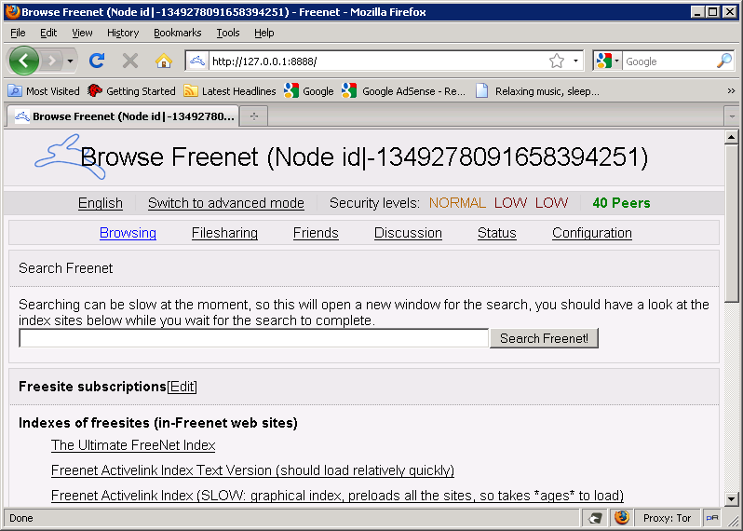
What does it look like to the user?

Slide 28
Key types
URI Example: http://127.0.0.1:8888/USK@0I8gctpUE32CM0iQhXaYpCMvtPPGfT4pjXm01oid5Zc,3dAcn4fX2LyxO6uCnWFTx-2HKZ89uruurcKwLSCxbZ4,AQACAAE/Ultimate-Freenet-Index/52/
CHK - Content Hash Keys
These keys are for static content, and the key is a hash of the content.
SSK - Signed Subspace Keys
Used for sites that could change over time, it is signed by the publisher of the content. Largely superseded by USKs.
USK - Updateable Subspace Keys
Really just a friendly wrapper for SSKs to handle versions of a document.
KSK - Keyword Signed Keys
Easy to remember because of simple keys like “KSK@myfile.txt” but there can be name collisions.

Slide 29
Modes of operation
Opennet
Lets any one in
Darknet
Manually configured “friend to friend”

Slide 30
Applications
jSite
A tool to create your own Freenet site
http://freenetproject.org/jsite.html
Freemail
Email system for Freenet
http://freenetproject.org/freemail.html
Frost
Provides usenet/forum like functionality
http://freenetproject.org/frost.html
Thaw
For file sharing
http://freenetproject.org/thaw.html

Slide 31
Freenet Pros and Cons
Pros
Once you inject something into the network, it can stay there as long as it is routinely requested
Does a damn good job of keeping one anonymous
Awesome for publishing documents without maintaining a server
Cons
Slow
Not really interactive
Not used for accessing the public Internet
UDP based, which may be somewhat more noticeable/NAT issues
Not meant for standard IP protocols

Slide 32
What does the traffic look like?
(Keep in mind, this is just the defaults)
Local
FProxy: 8888/TCP (web interface)
Remote
Darknet FNP: 37439/UDP (used to connect to trusted peers i.e. Friends; forward this port if you can)
Opennet FNP: 5980/UDP (used to connect to untrusted peers i.e. Strangers; forward this port if you can)
FCP: 9481/TCP (for Freenet clients such as Frost and Thaw)

Slide 33

I2P
Invisible Internet Project

Slide 34
Overview
Who?
I2P developers, started by Jrandom.
http://www.i2p2.de/
Why?
“I2P is an effort to build, deploy, and maintain a network to support secure and anonymous communication. People using I2P are in control of the tradeoffs between anonymity, reliability, bandwidth usage, and latency.” ~ from the I2p web site
What?
Mostly other web sites on I2P (Eepsites), but the protocol allows for P2P (iMule, i2psnark), anonymous email and public Internet via out proxies.
How?
Locally ran proxy of a sort that you can connect to and control via a web browser.

Slide 35
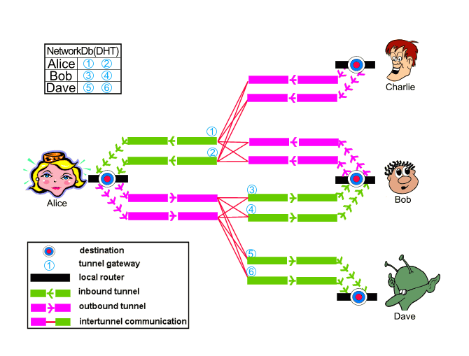
Layout
Image from http://www.i2p2.de/how_intro

Slide 36
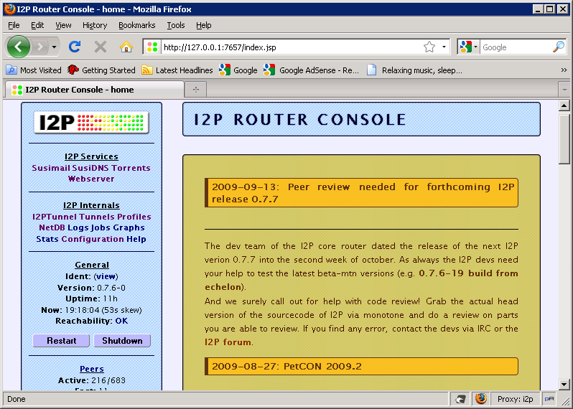
What does it look like to the user?

Slide 37
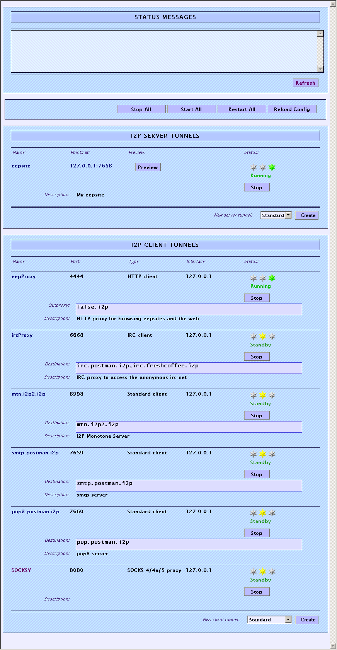
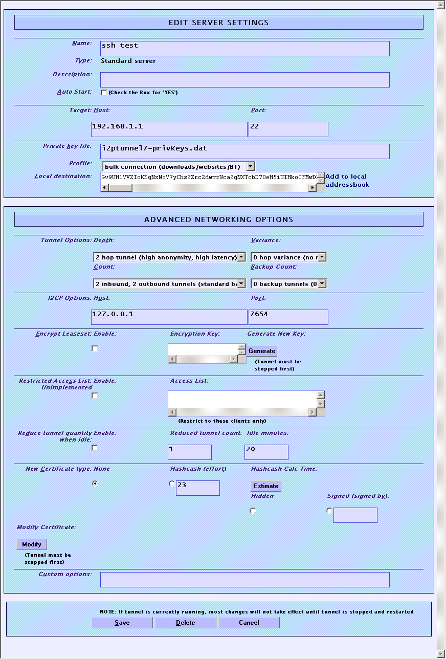
Tunnel Setup

Slide 38
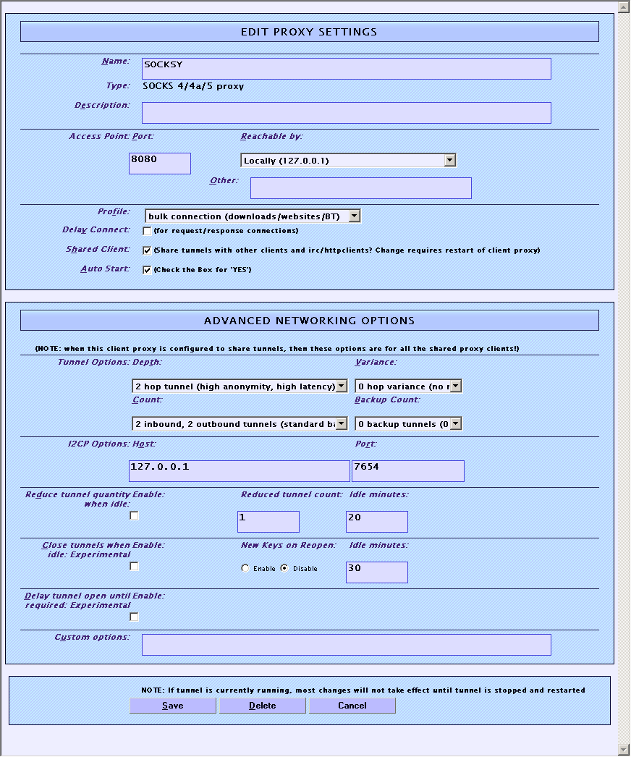
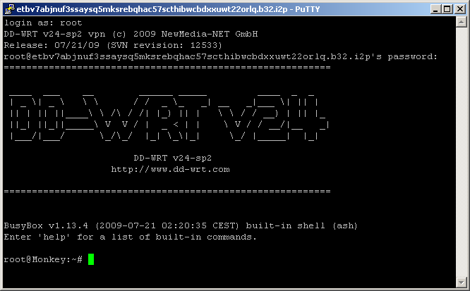
Tunnel Setup

Slide 39
Applications/Sites
I2PSnark
Built-in Bittorrent Client
iMule
Kad file sharing network client
http://www.imule.i2p.tin0.de/
Syndie
Blogging application, very alpha
I2PTunnel
Built-in, allows for setting up arbitrary TCP/IP tunnels between nodes
Out Proxies
For connecting to the normal Internet
Susimail
Built-in mail client, but you need to register an account at www.mail.i2p
InProxy I2P Eepsite
http://inproxy.tino.i2p/status.php

Slide 40
I2P Pros and Cons
Pros
Lots of supported applications
Can create just about any hidden service if you use SOCKS5 as the client tunnel
Eepsites somewhat faster compared to Tor Hidden Services (Subjective, I know)
Cons
UDP based, which may be somewhat more noticeable/NAT issues
Limited out proxies
Out proxies don’t handle SSL (I’m not 100% on this)

Slide 41
What does the traffic look like?
(Keep in mind, this is just the defaults)
Local
1900/udp: UPnP SSDP UDP multicast listener. Cannot be changed. Binds to all interfaces. May be disabled on config.jsp.
2827: BOB bridge, a higher level socket API for clients Disabled by default. May be enabled/disabled on configclients.jsp. May be changed in the bob.config file.
4444: HTTP proxy May be disabled or changed on the i2ptunnel page in the router console.
6668: IRC proxy May be disabled or changed on the i2ptunnel page in the router console.
7652: UPnP HTTP TCP event listener. Binds to the LAN address. May be changed with advanced config i2np.upnp.HTTPPort=nnnn. May be disabled on config.jsp.
7653: UPnP SSDP UDP search response listener. Binds to all interfaces. May be changed with advanced config i2np.upnp.SSDPPort=nnnn. May be disabled on config.jsp.
7654: I2P Client Protocol port, used by client apps. May be changed with the advanced configuration option i2cp.port but this is not recommended.
7655: UDP for SAM bridge, a higher level socket API for clients Only opened when a SAM V3 client requests a UDP session. May be enabled/disabled on configclients.jsp. May be changed in the clients.config file with the SAM command line option sam.udp.port=nnnn.
7656: SAM bridge, a higher level socket API for clients Disabled by default for new installs as of release 0.6.5. May be enabled/disabled on configclients.jsp. May be changed in the clients.config file.
7657: Your router console May be changed in the clients.config file
7658: Your eepsite May be disabled in the clients.config file
7659: Outgoing mail to smtp.postman.i2p May be disabled or changed on the i2ptunnel page in the router console.
7660: Incoming mail from pop.postman.i2p May be disabled or changed on the i2ptunnel page in the router console.
8998: mtn.i2p2.i2p (Monotone - disabled by default) May be disabled or changed on the i2ptunnel page in the router console.
32000: local control channel for the service wrapper
Remote
Outbound 8887/udp to arbitrary remote UDP ports, allowing replies
Outbound TCP from random high ports to arbitrary remote TCP ports
Inbound to port 8887/udp from arbitrary locations
Inbound to port 8887/tcp from arbitrary locations (optional, but recommended by default, I2P does not listen for inbound TCP connections)
Outbound on port 123/udp, allowing replies for I2P's internal time sync (via SNTP)

Slide 42
Some common Darknet weaknesses
Not all Darknets have all of these, but all of them have some of them ☺
Remote:
Traffic analysis
DNS leaks
Cookies from when not using the Darknet
Plug-ins giving away real IP
http://ha.ckers.org/weird/tor.cgi
http://evil.hackademix.net/proxy_bypass/
Un-trusted peers
Un-trusted exit points
The snoopers may not know what you are sending, or to who, but they may know you are using a Darknet and that could be enough to take action.
Local:
Cached data and URLs (Privacy mode FTW)
http://www.irongeek.com/i.php?page=videos/anti-forensics-occult-computing

Slide 43
Things to worry about if you decide to research Darknets
(IANAL)
Opening holes into your network
Encryption laws of your country
http://rechten.uvt.nl/koops/cryptolaw/
Inadvertently possessing child porn
  Wipe and forget?
  Tell the authorities?
  http://detroit.fbi.gov/crimes2.htm

Slide 44
Other things to check out
HP Veiled
http://www.internetnews.com/dev-news/article.php/3832326/HP+Veiled+A+Darknet+for+Browsers.htm
FlashBlock
https://addons.mozilla.org/en-US/firefox/addon/433
Multiproxy Switch
https://addons.mozilla.org/en-US/firefox/addon/7330
Wippien
http://www.wippien.com/

Slide 45
Events
Free ISSA classes
ISSA Meeting
http://issa-kentuckiana.org/
Louisville Infosec
http://www.louisvilleinfosec.com/
Phreaknic/Notacon/Outerz0ne
http://phreaknic.info
http://notacon.org/
http://www.outerz0ne.org/
Notes:
Beg for hardware donations. ☺

Slide 46
Thanks
Folks at Binrev and Pauldotcom
Louisville ISSA
Hacker Consortium
Free ISSA Classes

Slide 47
Helping with the free classes
Got old hardware you would like to donate?
Is there a subject you would like to teach?
Let others know about upcoming classes, and the videos of previous classes.

Slide 48
Questions?
42

