Slide 1
Programmable Hid USB Keyboard/Mouse Dongle for pen-testing
Adrian Crenshaw

Slide 2

About Adrian
I run Irongeek.com
I have an interest in InfoSec education
I don’t know everything - I’m just a geek with time on my hands
Notes:
Take a note from Johnny Long’s book, and Bruce Potter’s book.

Slide 3

First, a little story
I was given a device called a Phantom Keystroker at Shmoocon 2010 for doing a FireSide talk
Meant to annoy someone by sending keystrokes and mouse movements
But, what if it was programmable?

Slide 4


Darren and Robin
Darren Kitchen (media mogul)
and Robin Wood (code deity)
I knew Darren had been working
with the U3 thumb drives for
automated attacks, so I went to him with the idea
Devious minds think alike! They were already developing it!
They are working on a product (USB Rubber Ducky):
http://www.hak5.org/store
Darren Kitchen http://hak5.org
Robin Wood
http://digininja.org

Slide 5
Playing with the idea
If you want something nicer, wait for Darren and Robin’s tool
For those that like to “Go ugly early”, hold on for the rest of this presentation
Three notes in my defense:
I’m new to microcontrollers
I suck at soldering (Like an epileptic alcoholic with DTs soldering with an aluminum baseball bat)
I apparently suck at using rotary tools too

Slide 6
Why would you want a programmable keystroke device?
Likely types faster than you can, without errors
Works even if U3 autorun is turned off
Draws less attention than sitting down in front of the terminal would. The person turns their head for a minute, the pen-tester plugs in their programmable USB key stroke dongle, and Bobs your uncle, instant pwnage.
Can also be set to go off on a timer when you know a target will be logged in
Just use your imagination!

Slide 7
What sort of commands would you want to issue?
Add as user
Run a program
Copy files to your thumbdrive
Go to a website they have a cookie for, and do a sort of CSRF (sic)

Slide 8
What is in a name?
MintyPwn?
DIPStick?
Programmable Hid USB Keyboard/Mouse Dongle?
Maybe an acronym? Let’s see:
Programmable Hid USB Keyboard/Mouse Dongle?
PHUKD

Slide 9
Ok, we have some names, not how would we build one?
Did some Googling…
Found some limited items…
Then I found…

Slide 10
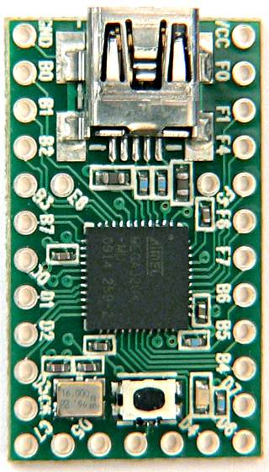
The Teensy
1.2 by 0.7 inch
AVR processor, 16 MHz
Programmable over Mini USB in C or Arduino dev package
$18 to $27
USB HID Support!!!
http://www.pjrc.com/teensy/

Slide 11

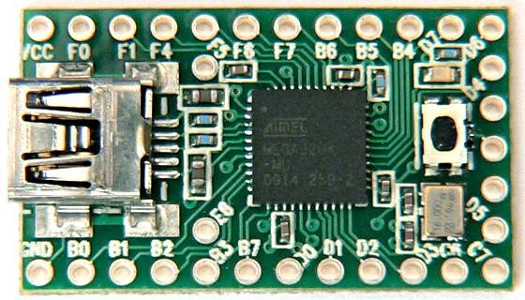



Butt Ugly Schematic
Photoresistor that is above 10K Ω in the dark, and less than 10K Ω in the light
USB
Connector
10K Ω Resistor
DIP Switches
Common Ground
Please note that the Teensy can use internal pullup resistors

Slide 12
Code Example
int ledPin = 11; // LED connected to digital pin 13
// The setup() method runs once, when the sketch starts
void setup() {
// initialize the digital pin as an output:
pinMode(ledPin, OUTPUT);
pinMode(PIN_D2, INPUT_PULLUP); // Pushbutton
}
// the loop() method runs over and over again,
// as long as the Arduino has power
void loop()
{
if (digitalRead(PIN_D2)) {
digitalWrite(ledPin, LOW); // set the LED off
}
else {
// Keyboard.set_modifier(MODIFIERKEY_CTRL|MODIFIERKEY_ALT);
digitalWrite(ledPin, HIGH); // set the LED on
Keyboard.set_modifier(128); //Windows key
Keyboard.set_key1(KEY_R); // use r key
Keyboard.send_now(); // send strokes
Keyboard.set_modifier(0); //prep release of control keys
Keyboard.set_key1(0); //have to do this to keep it from hitting key multiple times.
Keyboard.send_now(); //Send the key changes
delay(1500);
Keyboard.print("notepad.exe");
delay(500);
Keyboard.set_key1(KEY_ENTER);
Keyboard.send_now();
Keyboard.set_key1(0);
Keyboard.send_now();
delay(1000);
Keyboard.print("Adrian Was here!!! :)");
delay(2000); }
}

Slide 13
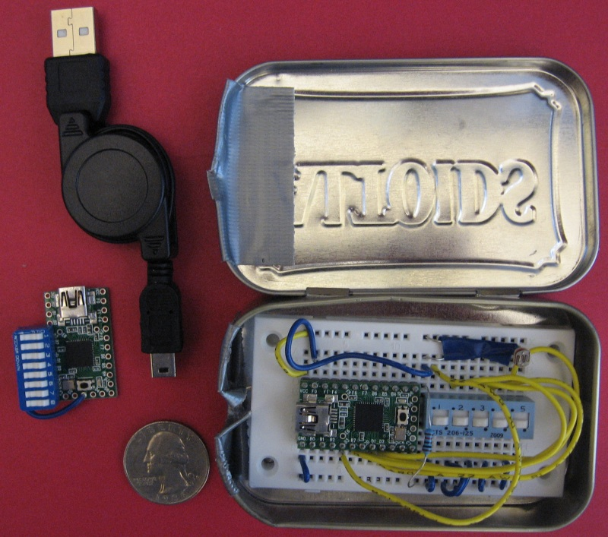
Device Demo

Slide 14
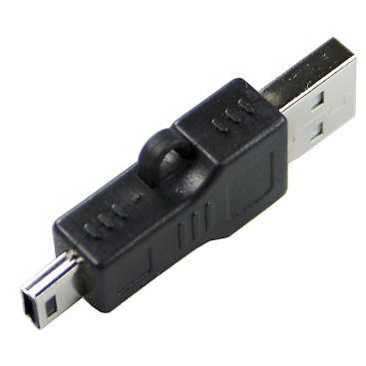

Other ideas
Embed a hub and storage in better packaging
http://www.dealextreme.com/details.dx/sku.2704~r.48687660
Leave it around in a thumb drive package for unsuspecting people to pick up and use
Trojaned Hardware: Use a timer or sensor and embed it in another device you give to the target as a “gift“
Have it “wake up”, mount onboard storage, run a program that covers what it is doing (fake BSOD for example), does its thing, then stops (leaving the target to think “it’s just one of those things”)
Default BIOs password brute forcing?

Slide 15
Links
Hak5
http://www.hak5.org/store
Teensy Product Page
http://www.pjrc.com/teensy/index.html
Code will be on my site soon
http://www.irongeek.com/

Slide 16
Events
Free ISSA classes
ISSA Meeting
http://issa-kentuckiana.org/
Louisville Infosec
http://www.louisvilleinfosec.com/
Phreaknic/Notacon/Outerz0ne
http://phreaknic.info
http://notacon.org/
http://www.outerz0ne.org/
Notes:
Beg for hardware donations. ☺

Slide 17
Questions?
42

